Slide 1
Write Meaning, Definition and Features of Advertising
Meaning:- The word advertising comes from Latin word “Advertere” which means to turn the mind towards .
The primary goal of advertising is to attract attention of audience and induce them to purchase advertising products and services.
Definition:- Definition AMA defines (American Marketing
Association)
“Any paid form of Non personal presentation,
Promotion of ideas, goods and service by an
indentified sponsor.”

Slide 2
Welcome to all
for the Advertising Online lecture
Chapter 4- Brand building and Special Purpose of Adverting
By
Dr. Dhiraj Ovhal
HOD of Commerce

Slide 3
Q.3 Brand Equity:-
Meaning:-
Every brand has value, and the value of a brand is brand equity.
Definition:-
Edward Taiber defines brand equity as
“ The incremental value of a business above the value of physical assets due to the market position achieved by its brand and the extension potential of the brand”.

Slide 4
Q.4 Brand Equity concept and Factors ?
Meaning:-
To create addition values and images in the mind of customers ( Nirma Washing powder and Nirma Biscuits
Dettol soft drink...)
Definition :-
Edward Tauber defines "The incremental value of business above the value of its physical assets due to market position achieved by its brand and the extension potential of the brand ."

Slide 5
Factors affecting brand equity
Brand loyalty :- Colgate, Bata chappal… continues and regularly purchase
Brand name Awareness :- name ,colour, size, shape to easy identify
Perceived Quality of the brand :- :- I-Phone --- high quality
Brand association:- Lux soap- bollywood actress, Goa- beautiful beaches, kearla- Back water tourism and Aaurveduc massage.
After sales services:-
Brand ambassadors:- Amitabha, Virat, Dhoni
Brand patent :-
Brand logo:- NIKE ✔ + for dettol soap

Slide 6
Brand loyalty :- Colgate, Bata chappal… continues and regularly purchase

Slide 7
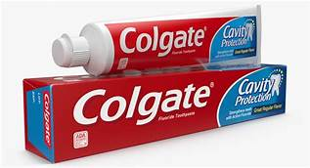
Brand loyalty:-
Satisfied customers of products
Customers are not only purchasing products but also recommend or suggested to their family members of society.
It is called as Evangelist

Slide 8
2.Brand name Awareness :- name ,colour, size, shape to easy identify

Slide 9
2. Brand Name awareness :-
In the mind of customers
Corporate name:- Tata Salt, Tata Nano, Tata Hexa,
Corporate cum Individual brand name :- Cadbury dairy milk
Umbrella name:- Amul Butter, Amul milk, Amul chocolate
Founder name:- Colgate,Nestle, Ford

Slide 10
3.Perceived Quality of the brand :- :- I-Phone --- high quality

Slide 11
4. Brand association:-
Lux soap- bollywood actress,
Goa- beautiful beaches,
kearla- Back water tourism and Aaurveduc massage.

Slide 12
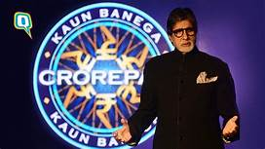
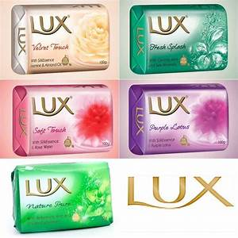
3. Brand Association:-
A brand must link or connect to certain assocaition
Lux soap- Association of bollywood actress
Goa- Association of beautiful beaches
kerala- Backwater experience and Ayurvedic massage

Slide 13
5.After sales services:-

Slide 14
4. After sales service :-
It is providing to make difference in brand equity
It is applicable consumer durable products
Warranty and Guarantee
To provide staff training for after sales service.

Slide 15
6.Brand ambassadors:- Amitabha, Virat, Dhoni

Slide 16
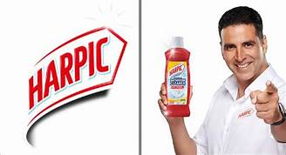
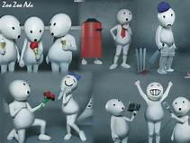
5. Brand Ambassadors :-Famous personality to promote products as brand ambassadors.

Slide 17
7. Brand patent :-

Slide 18
6. Brand patent :-
Company attain patent for new and innovative products
Need to register under Patent Act
In India products may be registered under Patents (Amendment) Act 2005

Slide 19
8.Brand logo:- NIKE ✔ + for dettol soap

Slide 20
7. Brand Logo :- along with brand name it facilitate to customers
Nike √,

Slide 21
Factors affecting brand equity
Brand loyalty :- Colgate, Bata chappal… continues and regularly purchase
Brand name Awareness :- name ,colour, size, shape to easy identify
Perceived Quality of the brand :- :- I-Phone --- high quality
Brand association:- Lux soap- bollywood actress, Goa- beautiful beaches, kearla- Back water tourism and Aaurveduc massage.
After sales services:-
Brand ambassadors:- Amitabha, Virat, Dhoni
Brand patent :-
Brand logo:- NIKE ✔ + for dettol soap

Slide 22
Thank You

Slide 23
Attendance Link
https://forms.gle/U4Da9ykpniL3tpCdA
(Mention date at last point)

